Slide 1
Uncertainty, Standard Error and Confidence intervals
(for note-taking only. See the html version for interactive elements)
Martina Sladekova

Slide 2
Today…
Recap of sampling from populations
Uncertainty in research and estimation
Sampling distribution revisited
Standard error of the mean
Confidence intervals: what they are, and what they are not
Notes:
Add alt text to images

Slide 3
LAST WEEK: Jennifer undertook a determined journey to find out just how clever Jessie (left) is compared to all the other dogs in the population.
THIS WEEK: What if we don’t know anything about the population?

Slide 4



Slide 5
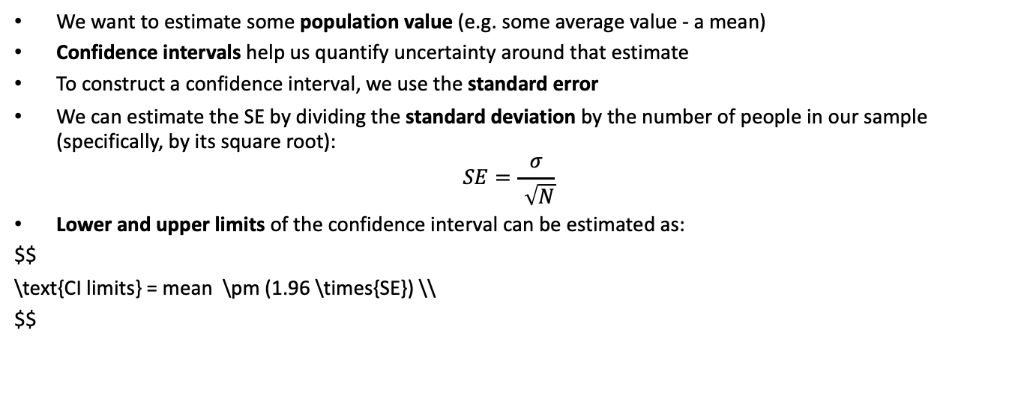
The whole game
We want to estimate some population value (e.g. some average value - a mean)
Confidence intervals help us quantify uncertainty around that estimate
To construct a confidence interval, we use the standard error
We can estimate the SE by dividing the standard deviation by the number of people in our sample (specifically, by its square root):
$$SE=\frac{σ}{\sqrt{N}}$$
Lower and upper limits of the confidence interval can be estimated as:
$$ \text{CI limits} = mean \pm (1.96 \times{SE}) \\ $$

Slide 6
Sampling from populations
We want to learn something about the population
But we only have access to a sample (often a small one)
The sample estimate is our best guess
What is an estimate?
An estimate can take many different forms. For example, we might be interested in comparing groups, in which case the estimate can be the difference in group means on some variable of interest. Or we might want to know whether two variables are associated, where the estimate is some measure of association (e.g. a correlation coefficient, or a b value which will be covered later in the term).

Slide 7
Some average facts
The average person (apparently)…
drinks 730 cups of coffee per year (twice as much for academics, incl. students) ☕
spends 192 minutes a day watching TV 📺
eats 250 cloves of garlic per year 🧄
takes 3500 steps each day 🚶
falls asleep in 7 minutes 😴

Slide 8
Doomscrolling
“… refers to a unique media habit where social media users persistently attend to negative information in their newsfeeds about crises, disasters, and tragedies.”
- Sharma, Lee, and Johnson (2022)
Research question...
How much does an average person doomscroll?

Slide 9
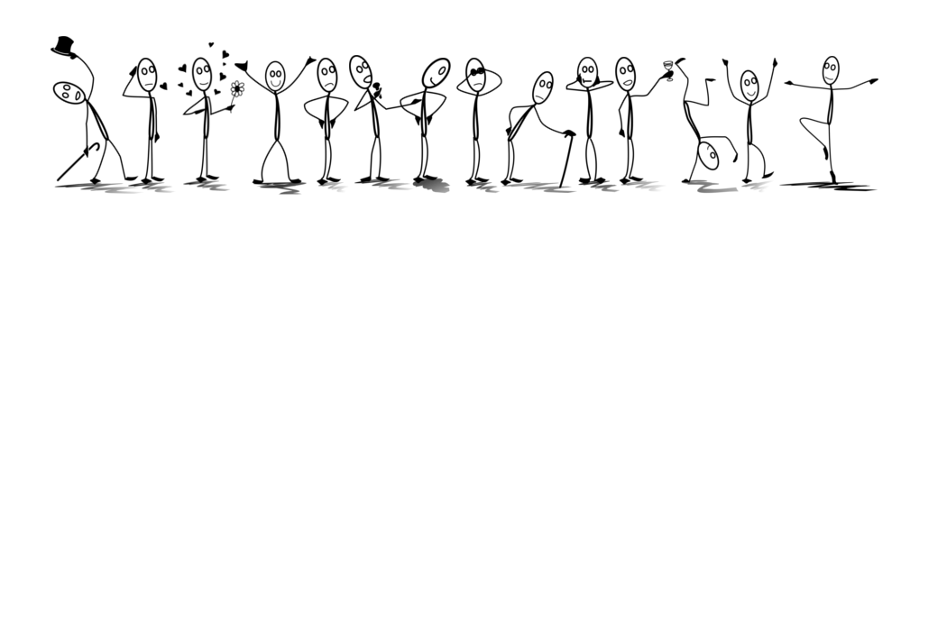

Slide 10
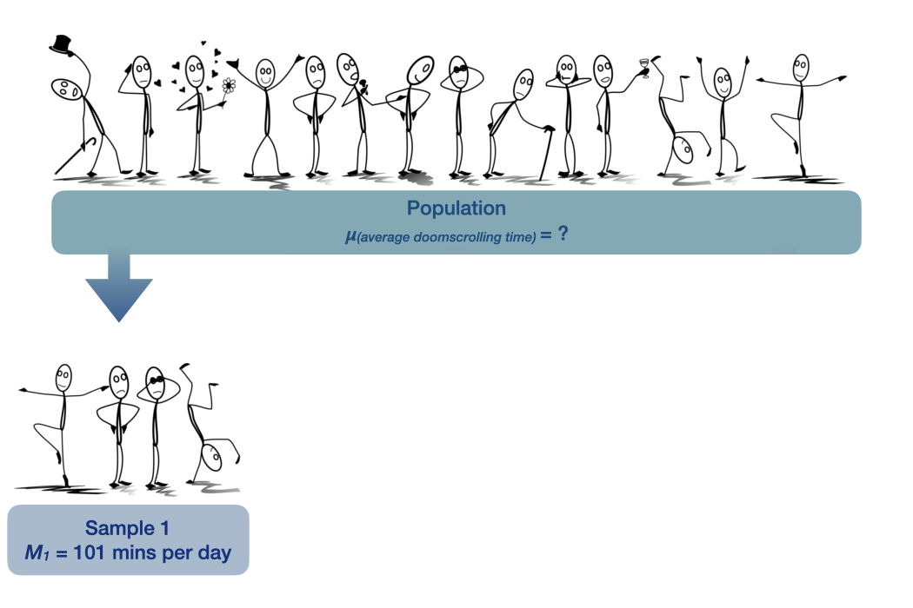

Slide 11
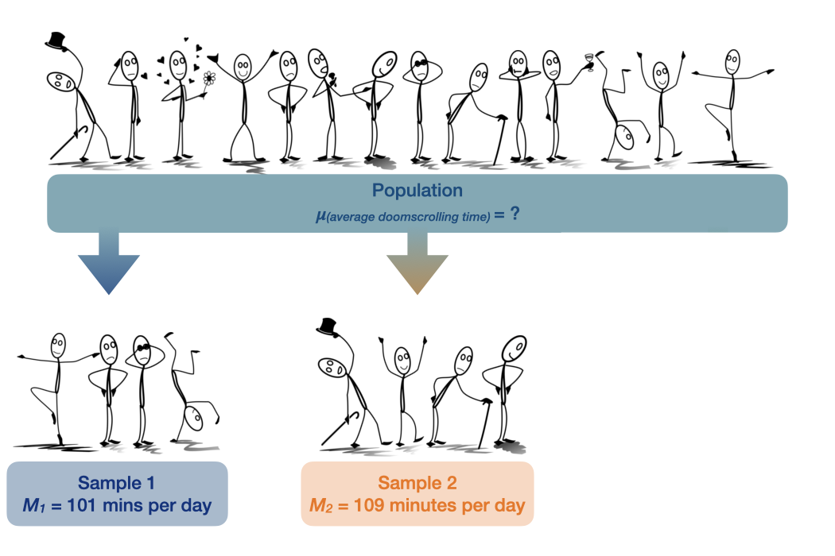

Slide 12
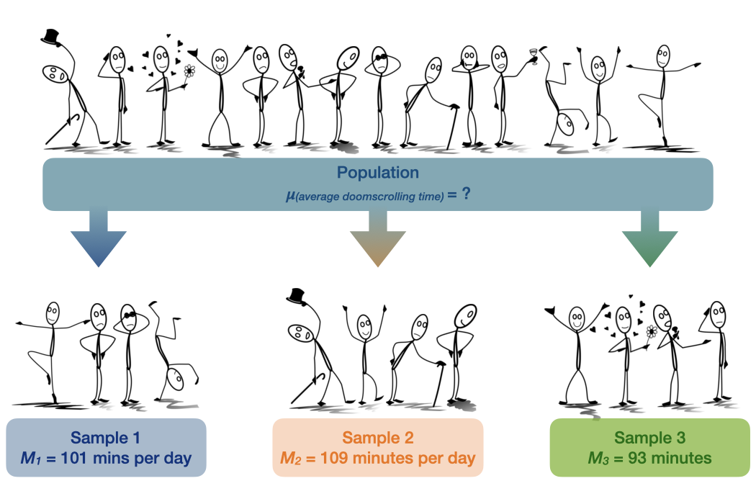

Slide 13
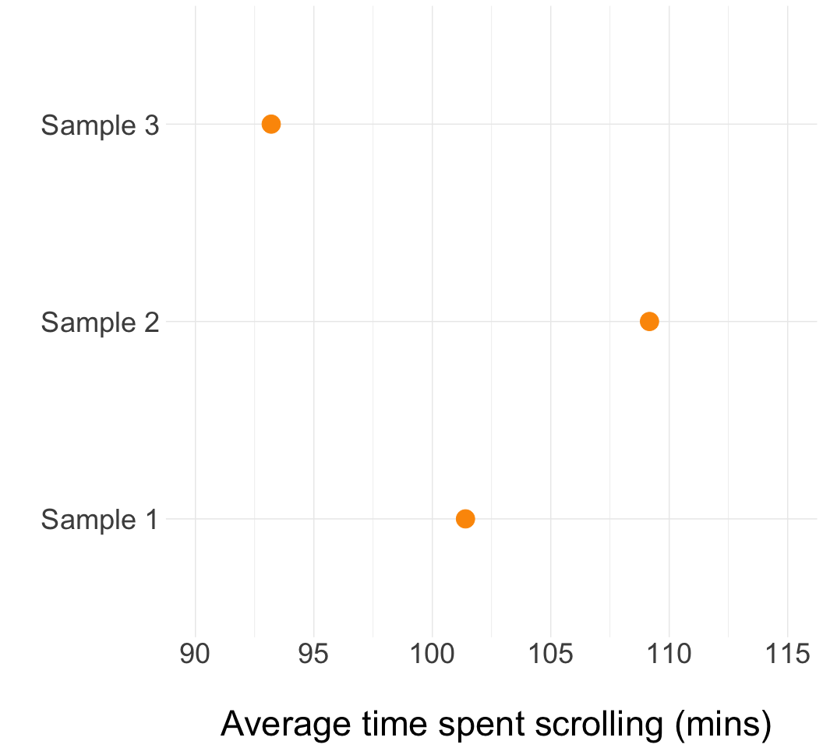
Uncertainty in research and estimation
The problem: Each time we take a sample, we get a different estimate.
How do we know if our estimate is accurate and close to the real population value?

Slide 14
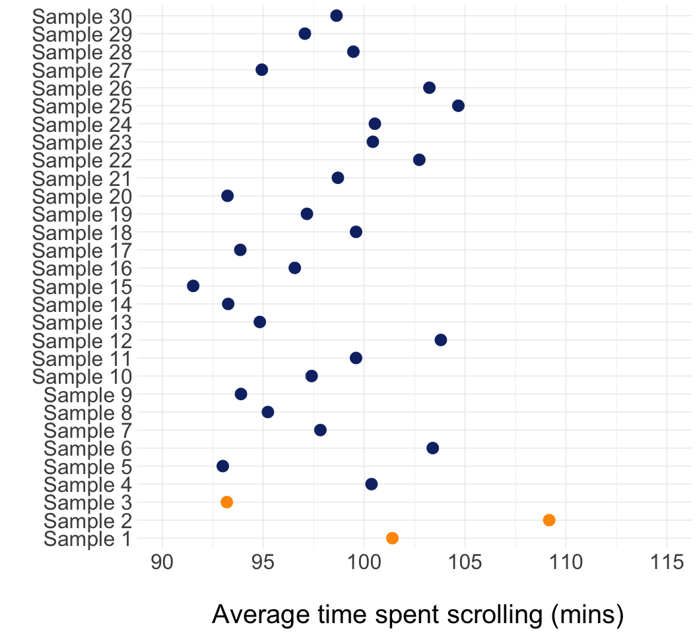
Uncertainty in research and estimation
The problem: Each time we take a sample, we get a different estimate.
How do we know if our estimate is accurate and close to the real population value?

Slide 15
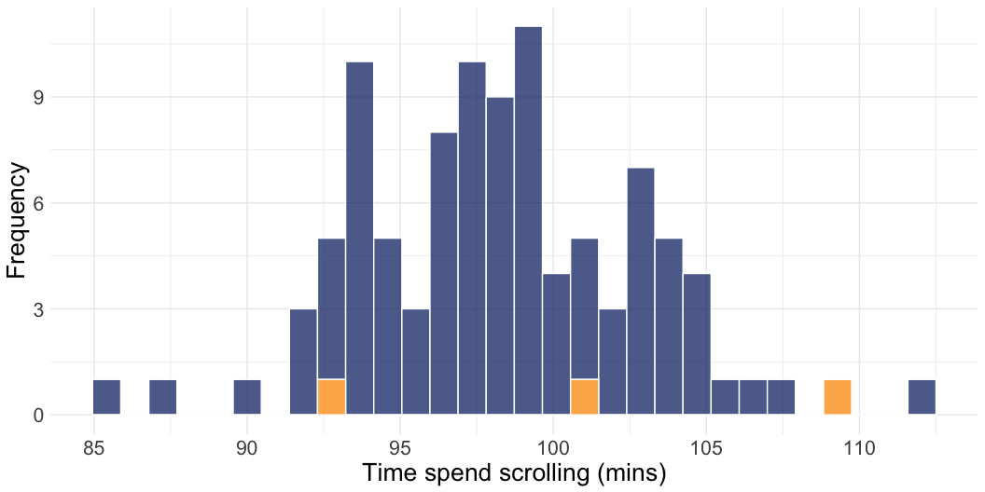
Sampling distribution revisited
We can plot the estimates in a histogram to see how they’re distributed
x axis shows the spread of the values, y axis shows how many times each value occurs

Slide 16
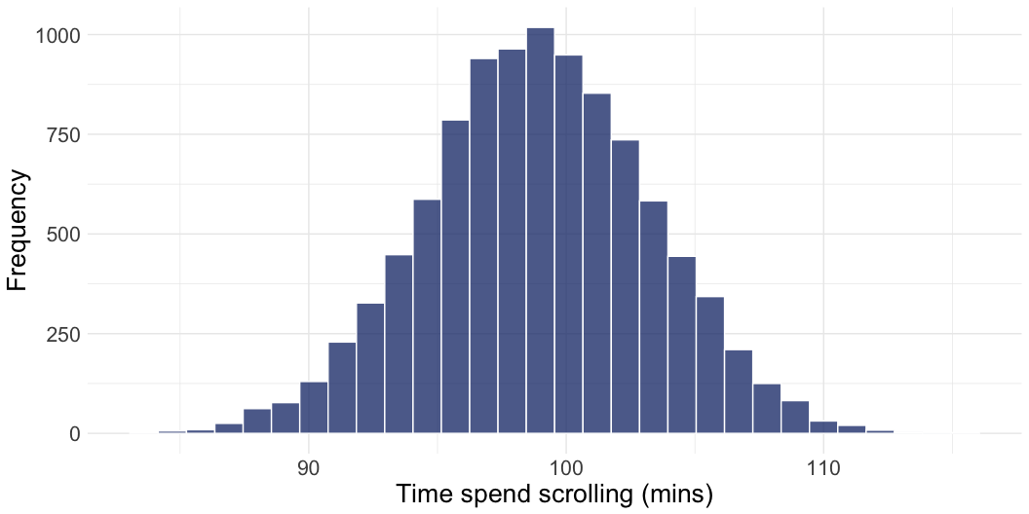
Sampling distribution revisited
We can repeat the process infinite number of times - as long as our sample is large enough, the sampling distribution of the estimates will be normal
What is “large enough”? Some textbooks say 30, but more is often needed in real research.

Slide 17
Normal distribution is awesome
Normal distribution is useful, because we know a lot about it - a good way to describe it is by using a mean (central value) and a standard deviation (spread of the scores)
Standard error is the term we use for standard deviation when talking about sampling distributions

Slide 18
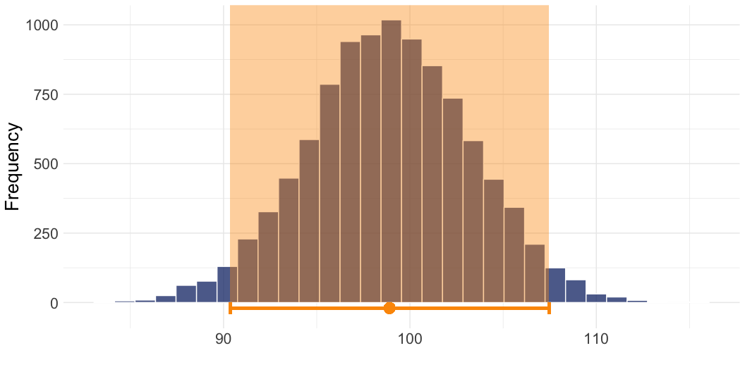
Normal distribution is awesome
We know that 95% of scores will fall within approximately 2 standard errors from the mean (or 1.96 if we want to precise)
We can use this knowledge to construct an interval around the mean showing us a range of plausible values

Slide 19
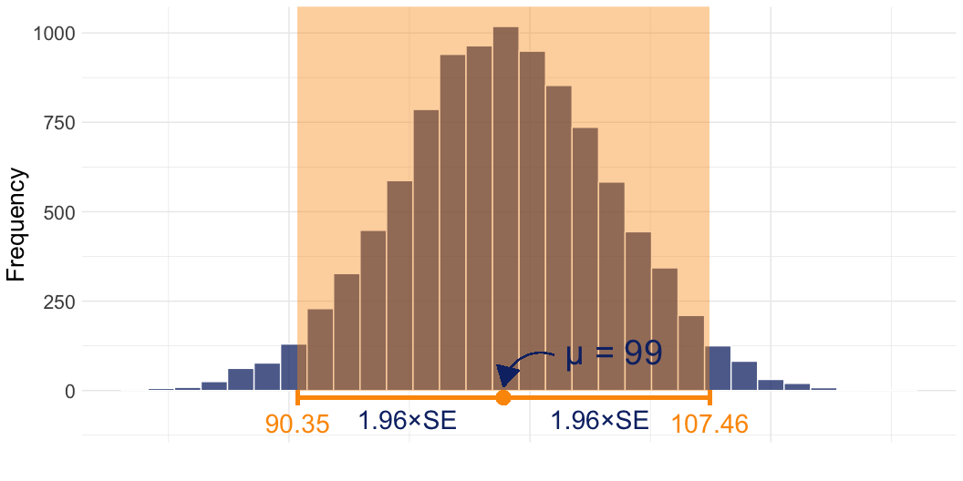
Normal distribution is awesome
We know that 95% of scores will fall within approximately 2 standard errors from the mean (or 1.96 if we want to precise)
We can use this knowledge to construct an interval around the mean showing us a range of plausible values

Slide 20
But wait…
Sampling distributions don’t exist “in the wild”. They are a hypothetical statistical concept.
Remember: standard error refers to the standard deviation of the sampling distribution (created by re-sampling and computing the mean infinite number of times), but we only have access one sample with one mean.
Therefore, if we want to use the standard error to construct an interval, we need to estimate it from our sample.

Slide 21
Estimating the standard error
Equation:
$$SE=\frac{σ}{\sqrt{N}}$$
Translation:
$$\text{standard} \text{error}=\frac{\text{sample} \text{standard} \text{deviation}}{\text{(}\text{the} \text{square} \text{root} \text{of}\text{) }\text{the} \text{sample} \text{size}}$$
In R:
se = sd(data$variable) / sqrt(n)

Slide 22
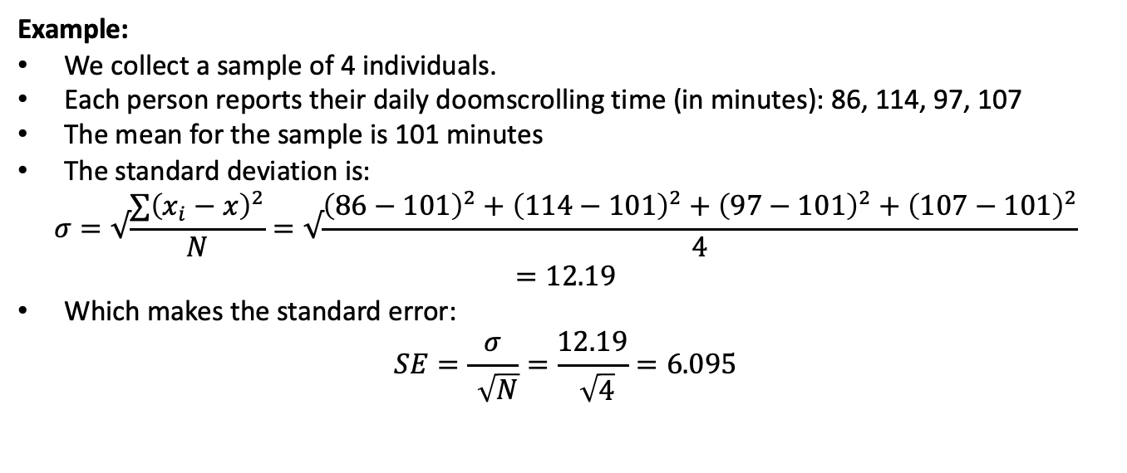
Estimating the standard error
Example:
We collect a sample of 4 individuals.
Each person reports their daily doomscrolling time (in minutes): 86, 114, 97, 107
The mean for the sample is 101 minutes
The standard deviation is:
$$σ=√\frac{∑{\left(x_{i}−x\right)}^{2}}{N}=√\frac{{\left(86−101\right)}^{2}+{\left(114−101\right)}^{2}+{\left(97−101\right)}^{2}+{\left(107−101\right)}^{2}}{4}=12.19$$
Which makes the standard error:
$$SE=\frac{σ}{\sqrt{N}}=\frac{12.19}{\sqrt{4}}=6.095$$

Slide 23
Confidence intervals
Average doomscrolling time for the sample: 101 minutes
Standard deviation: 12.19
Standard error: 6.095
$$ \text{Lower CI limit} = \text{sample mean} - 1.96 \times\text{SE} \\ \text{Upper CI limit} = \text{sample mean} + 1.96 \times\text{SE} $$
$$ \text{Lower CI limit} = 101 - 1.96 \times6.095 = 89.054\\ \text{Upper CI limit} = 101 + 1.96 \times6.095 = 112.946 $$
You might see in a paper…
“The average doomscrolling time in our sample was 101 minutes (SD = 12.19) 95% CI [89.05, 112.95].”

Slide 24
CIs for small samples
Remember: sampling distribution of the mean will have a normal shape as long as the sample size large enough
Smaller samples don’t approximate the sampling distribution very well. Because of this, we can’t rely on the value 1.96 to give us accurate intervals.
Instead, we can use the t-distribution

Slide 25
The t-distribution
The “critical t value” - i.e. the value of t which will give us the most accurate estimate of the confidence interval - depends on degrees of freedom (df), which in our case are related to the sample size.
When working with the mean, the degrees of freedom are calculated as N - 1.

Slide 26
The t-distribution
Instead of multiplying the standard error by 1.96, we multiply by the critical t value.
For example, in our sample of 4, the df is 4 - 1 = 3. Move the slider to df = 3 to see that the critical t value for 3 is 3.182

Slide 27
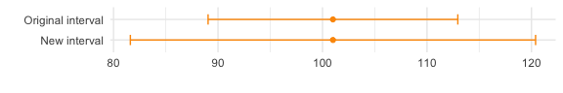
t-based confidence intervals:
Average doomscrolling time for the sample: 101 minutes
Standard error: 6.095
Critical t value: 3.182
$$ \text{CI Limits} = \text{mean} \pm3.182 \times\text{SE} \\ \text{CI Limits} = 101 \pm3.182 \times\text{6.095} \\ \text{CI Limits} = [81.606, 120.394] $$
Compare the new confidence interval [81.61, 120.394] with the confidence interval we got using the value 1.96: [89.05, 112.95]. The new CI is wider!

Slide 28
t-based confidence intervals:
This is to be expected - we have a tiny sample (N = 4), so there is a lot of uncertainty around whether the estimate of 101 minutes is actually representative of the population.
The larger the sample, the tighter the confidence intervals,. because the critical t gets smaller and smaller (note how t approaches 1.96 as the sample size (df) increases)

Slide 29
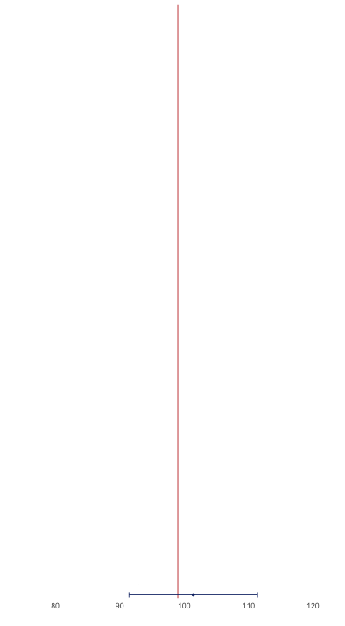
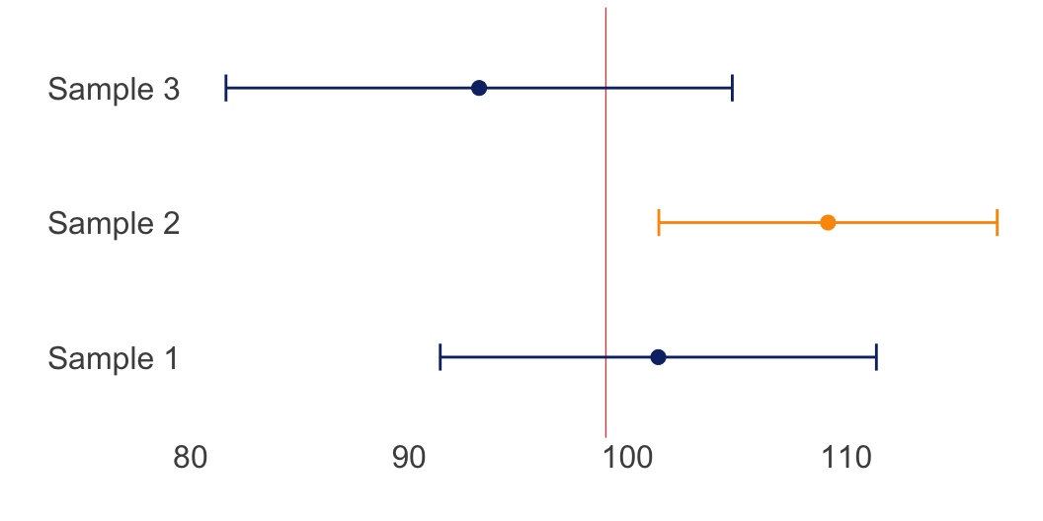
We take samples over and over again, compute the mean, and construct confidence intervals around that mean - 95% of them will contain the population value, the remaining 5% will not.
This is known as an interval with 95% coverage. 95% is the most common value that we choose, but it can take on other values as well (e.g 50%, 90%, 99%).

Slide 30
How to interpret confidence intervals
$$ \text{"The average doomscrolling time in our sample was} \\ \text{101 minutes (SD = 12.19) 95% CI [81.61, 120.39]."} $$

Slide 31
How to interpret confidence intervals
Correct interpretation:
ASSUMING THAT our sample is one of the 95% producing confidence intervals that contain the population value, then the population value for time spent doomscrolling per day is likely fall between 81.61 and 120.39 minutes.
However...
There is no guarantee that the assumption above is correct! And we just have to live our lives not knowing…

Slide 32

How *not* to interpret confidence intervals
Nope:
“We can be 95% confident that the population value falls between 81.61 and 120.39.”

Slide 33

How *not* to interpret confidence intervals
Also nope:
“There is 95% probability that the population value falls between 81.61 and 120.39.”

Slide 34

How to interpret confidence intervals
Correct interpretation
ASSUMING THAT our sample is one of the 95% producing confidence intervals that contain the population value, then the population value for time spent doomscrolling per day is likely fall between 81.61 and 120.39 minutes.

Slide 35
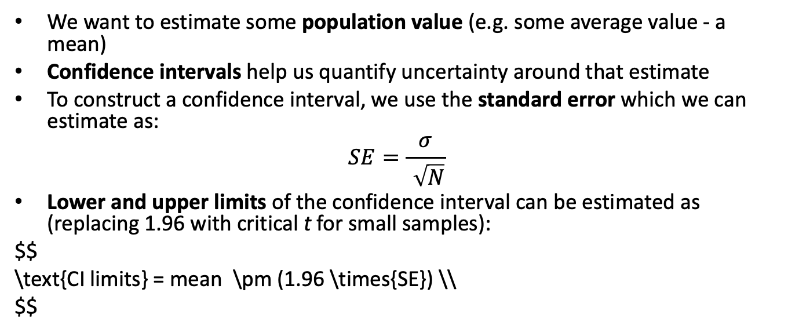
The whole game (again)
We want to estimate some population value (e.g. some average value - a mean)
Confidence intervals help us quantify uncertainty around that estimate
To construct a confidence interval, we use the standard error which we can estimate as:
$$SE=\frac{σ}{\sqrt{N}}$$
Lower and upper limits of the confidence interval can be estimated as (replacing 1.96 with critical t for small samples):
$$ \text{CI limits} = mean \pm (1.96 \times{SE}) \\ $$

Slide 36
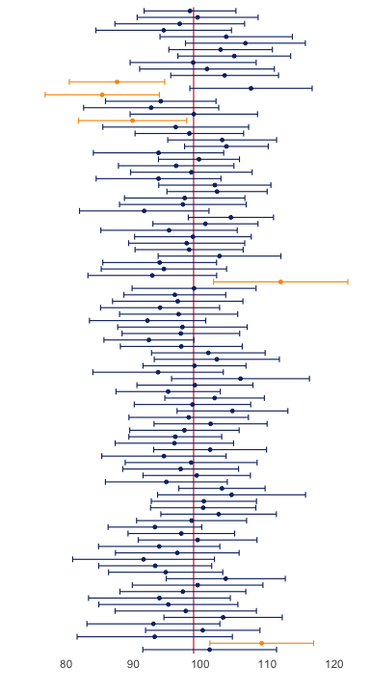
The bigger picture…
When interpreting a estimates and confidence intervals for your sample - always consider them as just one of many different possible estimates
This is why replication is important in science - our sample could easily be the one that misses the population value
Always be vary of studies placing too much confidence on a single finding

Slide 37
Next week’s fun:
Putting it all into practice:
Research questions
Good and bad hypotheses
Testing hypotheses with Null Hypothesis Significance Testing
A disappointing answer to why we’re so obsessed with the value 95%.

Slide 38
References
Sharma, Bhakti, Susanna S. Lee, and Benjamin K. Johnson. 2022. “The Dark at the End of the Tunnel: Doomscrolling on Social Media Newsfeeds.” Technology, Mind, and Behavior 3 (1). https://doi.org/10.1037/tmb0000059.

